Slide 1
Things to know about the skin in Proteus syndrome
Thomas Darling, M.D. Ph.D.
Professor and Chair of Dermatology
Uniformed Services University

Slide 2
Disclaimers
The opinions and assertions expressed herein are those of the author and do not reflect the official policy or position of the Uniformed Services University of the Health Sciences or the Department of Defense.
Neither I nor my family members have a financial interest in any commercial product, service, or organization providing financial support for this research.

Slide 3
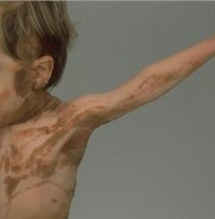
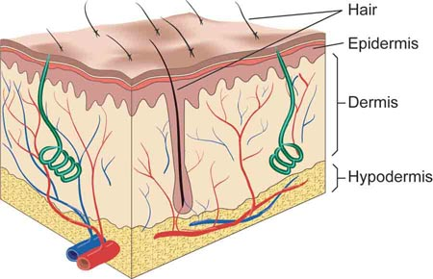
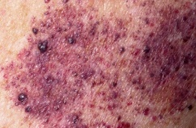
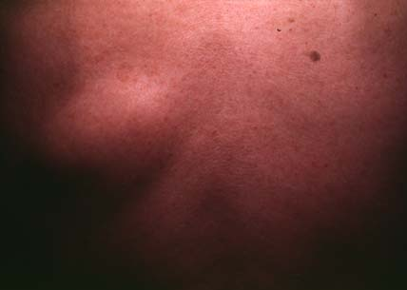
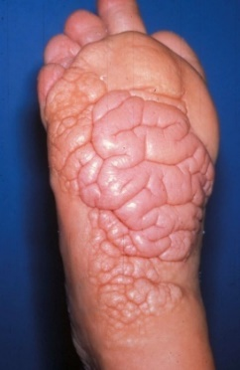
Types of skin changes in Proteus syndrome
Epidermal nevus
Vascular malformations
Lipomas
Connective tissue nevus
Notes:
May have one skin finding or all 4. May involve a large part of the body or small.

Slide 4
Locations
Torso, arms, legs
Torso and legs
Torso
Feet and hands
Epidermal Nevus
Vascular Malformation
Lipoma
Connective Tissue Nevus
J Am Acad Dermatol. 2005;52:834-8

Slide 5
Age of Onset
First year
First month
Later in first year
Later in first 2 years
Epidermal Nevus
Vascular Malformation
Number of Patients
Lipoma
Connective Tissue Nevus
A
B
C
D
E
J Am Acad Dermatol. 2005;52:834-8
Notes:
Age first noted is divided into (A) 0 to <1 month; (B) 1 month to<1 year; (C) 1 year
To<2 years; (D) 2 to<4 years; and (E) >4 years

Slide 6
Later new arrivals
Infrequent
Infrequent
Can occur
Typical
Epidermal Nevus
Vascular Malformation
Number of Patients
Lipoma
Connective Tissue Nevus
None
New
J Am Acad Dermatol. 2005;52:834-8

Slide 7
Growth
Stable
Stable
Grow
Grow
Epidermal Nevus
Vascular Malformation
Number of Patients
Lipoma
Connective Tissue Nevus
Stable
Spread
J Am Acad Dermatol. 2005;52:834-8

Slide 8
Frequency of skin changes
Epidermal Nevus
Vascular Malformation
Lipoma
Connective Tissue Nevus
Pediatr Dermatol. 2021;38:794-799.

Slide 9
Trends
Early onset, stable size and number
  Epidermal nevus
  Vascular malformations
Later onset, new lesions, grows
  Lipomas
  Connective tissue nevus

Slide 10
Cerebriform connective tissue nevus (CCTN)
One of the more characteristic skin changes
Typically arise in first 2 years
Most common on soles of feet, second most common palms
  Pediatr Dermatol. 2021;38:794-799
Early growth small “pre-CCTN”
  Am J Hum Genet. 2019;104:484-491
Can be difficult to diagnose in young children
Rarely late onset (age 19 years)
  Am J Med Genet A. 2022;188:2766-2771

Slide 11
Progression of CCTN
No changes
Pre-CCTN
Pre-CCTN plus CCTN
CCTN

Slide 12
Additional skin changes
Patchy dermal hypoplasia
  Arch Dermatol. 1997;133:77-80
Patches with increased hair growth
  J Am Acad Dermatol. 2021;84:415-424
Light or darks spots
Nail changes
  Pediatr Dermatol. 2021;38:794-799
Localized back acne
  JAAD Case Rep. 2020;6:1072-1074

Slide 13
Potential problems from skin changes
Appearance
Impaired function
Pain
Dry skin
Sensitive skin
Odor
Infection

Slide 14
Medical utility of skin changes
Diagnosis
  Clinical
  Molecular
Monitoring response to treatment

Slide 15
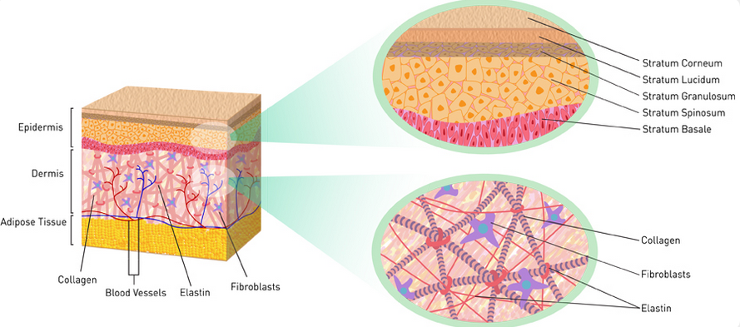
What causes these changes in skin?
Notes:
Too much of a good thing!

Slide 16

Normal appearing skin
Collagen
Fibroblast

Slide 17
Connective Tissue Nevus
Too Much Collagen
Activated Fibroblast

Slide 18
Drug
?

Slide 19
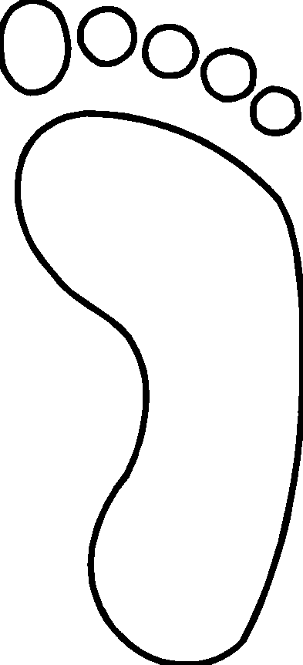
Typical progression
No Treatment

Slide 20
Growth of CCTN
J Am Acad Dermatol. 2018;78:725-732

Slide 21
Will treatment slow the rate of growth?
+ Treatment

Slide 22
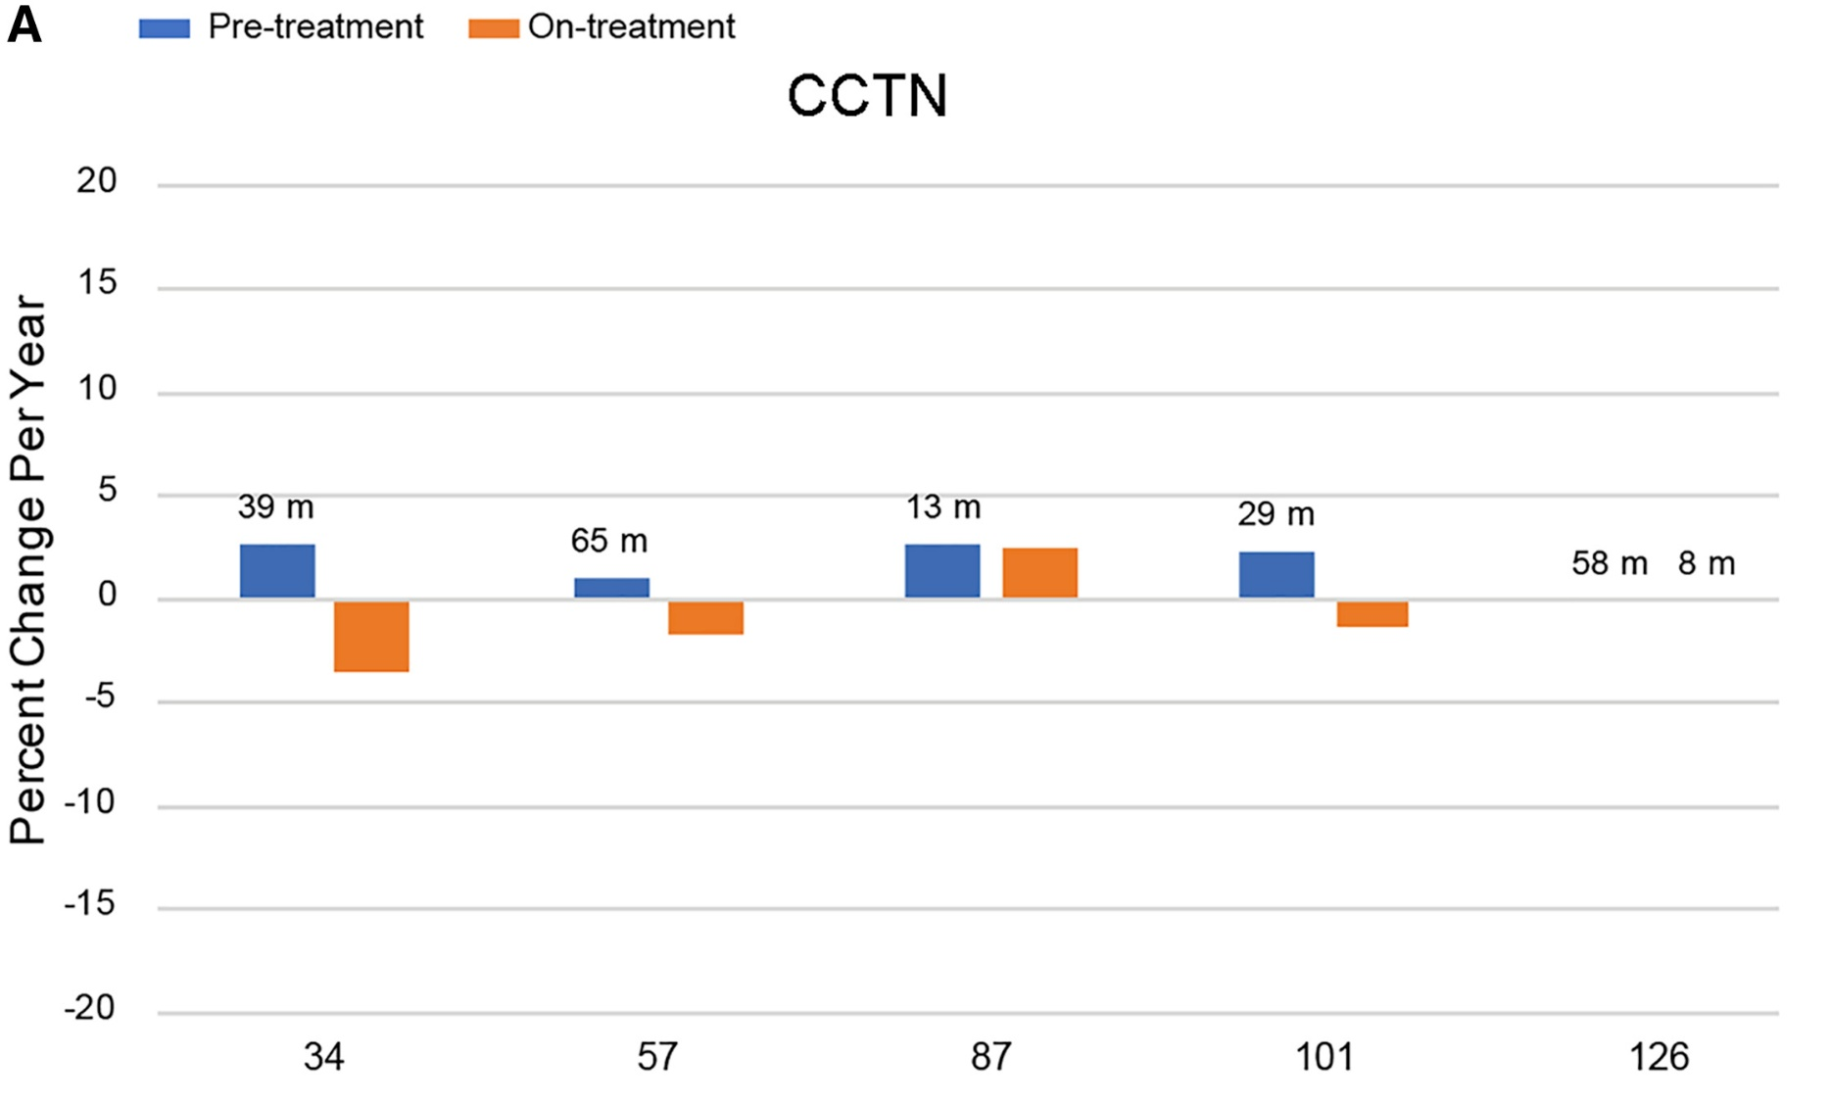
Miransertib
Am J Hum Genet. 2019;104:484-491

Slide 23
Gentle skin care
Skin care
  Washing, drying, use of moisturizers, avoid irritants
Sun protection
  Sun protective clothing
  Avoid sunlight during the middle of the day
  Broad-spectrum sunscreen
Clothing and Shoes
  Change socks, shoes that breathe, orthotic shoes

Slide 24
Approaches to treatment
Medical
  Topical or oral medications
  Clinical trials
Surgical
  Excision, Laser, Liposuction, others

Slide 25
Epidermal Nevi
Medical
  Topical retinoids, keratolytics, corticosteroids
  Systemic retinoids
  Topical sirolimus (J Am Acad Dermatol. 2022;87:407-409)
Surgical
  Laser ablation
    No difference pulsed CO₂ laser and Er:YAG laser (J Dermatolog Treat. 2017;28:452-457)
  Excision, shave
  Cryotherapy
    Particularly for small lesions (Dermatology. 2013;226:342-6).
  Dermabrasion
  Photodynamic therapy
Notes:
The current standard therapy for epidermal nevi is surgery or ablative CO2 laser treatment. Topical tretinoin cream (0.02 or 0.05) percent and 5-fluorouracil cream have been used in the treatment of both acanthosis nigricans and epidermal nevi with variable results [5]. Treatment with topical tretinoin cream 0.02 percent once daily was not effective in the present patient. Therefore, CO2 laser treatment will be initiated in the future. Furthermore, several small molecule tyrosine kinase inhibitors of FGFR3 are available and being evaluated for the treatment of acute myeloid leukemia. These drugs may also be useful in the treatment of other disorders associated with FGFR3 mutations, such as benign skin lesions.
Nine patients with verrucous epidermal naevi and two with extensive unilateral epidermal naevus were treated with cryosurgery. Two cycles of open spray technique were used, 10-15 sec each, depending on the size and extent of the naevus. Ten patients had their naevi treated successfully in 2-5 sessions with two cycles of therapy, and the cosmetic result was excellent with no scarring. One patient showed a relapse within 8 months after the treatment. One patient with phototype IV developed hypochromic scarring, but repigmentation occurred after 6 months. Postoperative healing time was 10-20 days.

Slide 26
Treatment of Dry Skin
Washing
  Tepid water
  Non soap cleanser (e.g. Cetaphil)
  Bath oil
  5 - 10 minutes
  Shower
  Pat dry
  Apply moisturizer
Moisturizers
  Apply after bathing and 2 – 4 times a day
  Lotions, ointments
  Active ingredients
    Alpha hydroxy acid, salicylic acid, ammonium lactate, urea
  Patient approval

Slide 27
Treatment of Sensitive Skin
Treat dry skin
  Watch for preservatives, fragrances in moisturizers
Avoid irritants
  Fabrics (wool, rough synthetic clothing)
  Soaps and detergents (industrial skin cleansers, borax, cleansers with abrasives)
  Solvents (gasoline, kerosene, turpentine)
  Acids, alkalis, metal salts, plants

Slide 28
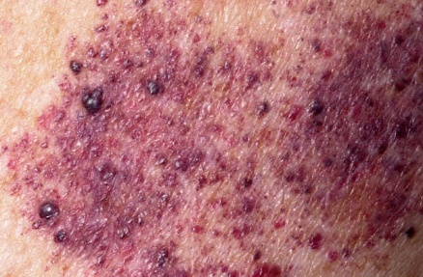
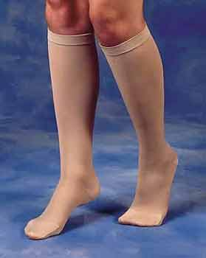
Vascular Malformations
Capillary malformation
  Pulsed-dye lasers
    Initiate early, multiple sessions
    May be beneficial to combine with topical sirolimus (Lasers Surg Med. 2016; 48:193-6; J Am Acad Dermatol. 2015;72:151-8 )
  Nd:YAG laser
    Median maximal improvement 70%, average 7 treatments (Lasers Surg Med. 2017;49:743-749)
    Minor skin blistering and breakdown (J Am Acad Dermatol. 2017;77:473-479)
  Intense pulsed light source
Venous malformation
  Compression stockings – proper fit and coverage
  Embolization
  Sclerotherapy
  Excision

Slide 29
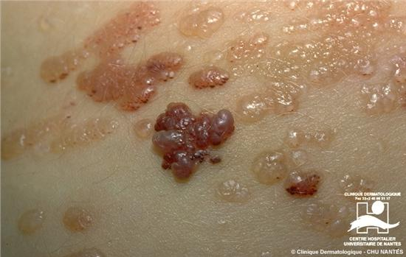
Vascular Malformations
Lymphatic malformations
  Topical sirolimus 1% ointment
    Two patients with microcystic lymphatic malformations showed improvement with treatment for 4 months (Pediatrics. 2017;139(5)).
  Leave undisturbed
  Excision
  Sclerotherapy
  Control infection

Slide 30
Lipomas
Surgical
  Excision
    Standard of care, effective, large scar
  Liposuction
    Leaves smaller scars than excision
      In 23 of 31 cases there were no complications
      Remainder had remnant lipoma, bruise, hematoma or immediate dimpling (J Eur Acad Dermatol Venereol. 2007;21:243-6)
    But not for fibrous lesions or combination lesions with vascular malformations

Slide 31

Connective Tissue Nevi
Good skin care
Custom fit orthotics
Surgery
  Excision (at time of orthopedic surgery)
  Scars on the sole of foot can be very painful
  Recurrences or new lesions common
Notes:
Anastasia Diapedic® Foot Cream
Brian recommends
Whole Leaf Aloe Barbadensis Extract, Safflower Oil, Paraffin, Octyl Stearate, Olive Oil, Propylene Glycol, Lanolin, Methyl Salicylate, Beeswax, Triethanolamine, Tocotrienol, Cetearyl Alcohol/Ceteth-20, Linoleic Acid/Linolenic Acid/Arachidonic Acid (Vitamin F), Eucalyptus Oil, Bergamot Oil, Evening Primrose Oil, Ascorbyl Palmitate, Tocopherol (Vitamin E), Ascorbic Acid (Vitamin C), Retinyl Palmitate (Vitamin A), Panthenol, Menthol, Camphor, Allantoin, Glyceryl Stearate, PEG-100 Stearate, Steareth-2, Steareth-21, Stearic Acid, Carbomer, Hydrolyzed Glycosaminoglycans, Cetyl Alcohol, Xanthan Gum, Sodium PCA, Imidazolinyl Urea, Propylparaben, Methylparaben.
Manufacturer
Anastasia Marie Laboratories, Inc.
800-542-7546

Slide 32
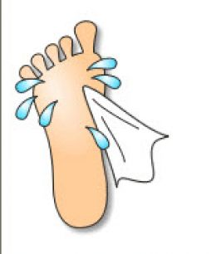
Causes of Odor
Moisture
Microorganisms
Skin folds

Slide 33
Treatment of Odor
Keep skin dry
  Shoes that breathe
  Cotton socks (no “fluff” that gets caught in grooves)
  Change socks
  Foot powder
  Hair dryer
  Gauze wedge
Reduce perspiration
  Tea Soaks
  Antiperspirants
    Aluminum chloride (Certain Dri)
  Iontophoresis (Drionic)
  ? Botox injection

Slide 34
Treatment of Odor
Reduce bacteria
  Antimicrobial cleanser
    Switch brand periodically
  Foot soaks
    10 min, 2-3 times daily
    Burow’s solution (Domeboro), dilute vinegar, dilute bleach
    Johnson’s Foot Soap (borax and bicarb)
    Dakin’s solution (hypochlorite)
  Clean between skin folds
    Cotton-tipped applicator (only early, before “tight”)
    Water jet (may feel funny), e.g. using handheld shower head
Notes:
Johnson’s Foot Soap - Soap, Sodium Sesquicarbonate, Sodium Borate, Sodium Bicarbonate, Caramel, Potassium Iodide, Bran, Iodoform.

Slide 35

Treatment of Odor
Prescription
  Aluminum chloride solution (e.g. Drysol)
  Topical antibiotics (e.g. Clindamycin solution)
  Treatment of infection (oral antibiotics, topical or oral antifungals)

Slide 36
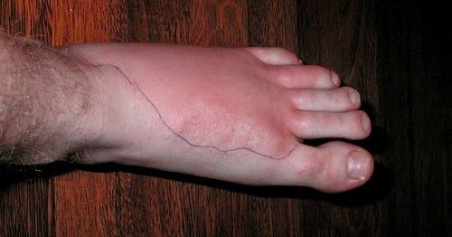
When to Seek Treatment of Skin Lesions
Oozing, bleeding
Signs of infection (warmth, fever, redness, swelling, pain, pus)
Rapid change or growth

Slide 37
Summary
Children and adults with Proteus syndrome have special needs for skin care
Different types of skin lesions are treated in different ways, some medically and some surgically
Progress is being made leading to improved treatments!

Slide 38
Acknowledgements
Proteus Syndrome Foundation
Patients and Families
Leslie Biesecker
  Julie Sapp
  Chris Ours
  Marjorie Lindhurst
MRSP Students
  Deeti Pithadia
  Alex Cartron
  Neera Nathan

