Slide 1
Lifelong Communication and Coping in Proteus Syndrome
Julie C. Sapp, ScM, CGC
Genetic Counselor, Center for Precision Health Research
October 7, 2022

Slide 2
About me
2004: first PSF conference
2005: started working at NIH

Slide 3
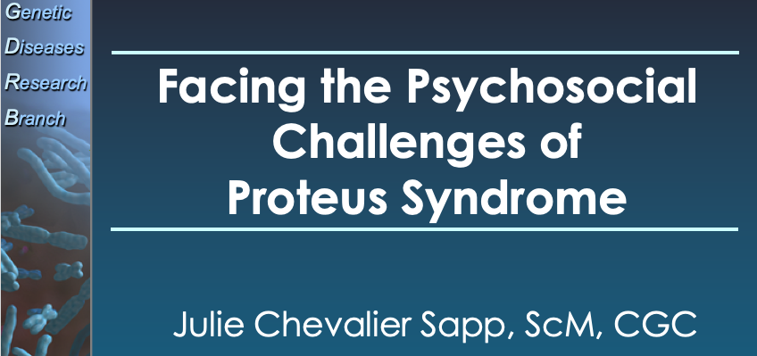
About me
2004: first PSF conference
2005: started working at NIH

Slide 4
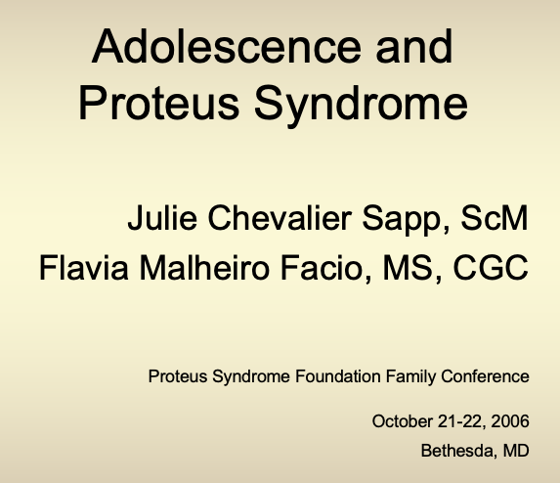
About me
2004: first PSF conference
2005: started working at NIH

Slide 5
Outline
Request: transition to from teen to adult in PS
Concrete strategies
Communication generally
Coping and communication are related
or
Nope

Slide 6
Successful navigation of medical encounters
Present for care
Provide context (history)
Describe problem (chief complaint)
Discuss treatments and options
Articulate and advocate for goals
Follow through with recommendations (comply)

Slide 7
Successful navigation of medical encounters
Present for care
Provide context (history)
Describe problem (chief complaint)
Discuss treatments and options
Articulate and advocate for goals
Follow through with recommendations (comply)

Slide 8
Knowledge and Skills
Identifying a healthcare provider
Understanding a health problem
Describing that problem (talking about it)
Answering specific questions
Contextualizing and summarizing
→ Consider the acute and the chronic

Slide 9
Early shared responsibility
Tell me about what’s going on? How have things been going recently?
Identifying a healthcare provider
Understanding a health problem
Describing that problem (talking about it)
Answering specific questions
Contextualizing and summarizing
→ Consider the acute and the chronic
Does it hurt here?
When did it start?

Slide 10
Successful navigation of medical encounters
Present for care
Provide context (history)
Describe problem (chief complaint)
Discuss treatments and options
Articulate and advocate for goals
Follow through with recommendations (comply)

Slide 11
Challenges in sharing responsibility
Discuss treatments and options
Articulate and advocate for goals
Follow through with recommendations (comply)
Treatments are painful, complicated, experimental, and/or risky
Uncertainty and rarity
Goals are a moving target
May not meet ideal goal
Early and required medical care makes it hard to offer choices
Parents have years of experience advocating for kids

Slide 12
Competing demands
Fostering independence
Never do for someone what they can do for themselves
“Normal” goal of parenting
Extra support required
Limitations and medical procedures (fragility)
Compensating for/making up for burden

Slide 13
Developmental perspective
Before your child is an adult, they are a teen
Before your child is a teen, they were a little (and then not-so-little) kid
Your child has always been part of family system that has been communicating about and coping with Proteus syndrome…and lots of other things.

Slide 14
Two big questions….
WHAT is happening?
WHY is it happening?
How does your family answer these questions?

Slide 15
“WHAT” communication in Proteus
We need to see the doctor
Our family is traveling to the NIH
We want to give you this medicine
You are having surgery in two weeks
That person is staring at me
A doctor is asking me lots of questions
You have Proteus syndrome
My leg bends less this year compared to last year
You need to have a blood test
There’s a problem we need to watch closely
Buying shoes is really complicated and there aren’t a lot of choices for me

Slide 16
“WHY” communication in Proteus
Because we hope the medicine helps you
So that your legs can work better
To check on how your body is handling the medicine
Because in Proteus syndrome, things can change or get worse over time
People are uncertain (at best) or rude/mean to those who have physical differences
Because these are the shoes that fit your feet the best
To learn more about you and your Proteus syndrome
Because this research study is not an option close to home
Because I love you and I want you to be as healthy as you can be

Slide 17
How we communicate with others is influenced by how we frame, understand, and sort out the WHATs and WHYs of any given situation

Slide 18
WHAT toolbox
Knowledge
Experience with communicating and talking
Planning, preparation, and practice
Developmental match

Slide 19
Understanding evolves throughout childhood
Age | Understanding | Example
4-6 years | Circular, magical | “You get sick because you eat too much candy.” “You are making me have this blood test because I was bad!”
6-8 years | Concrete | “What will it feel like to have surgery?”
8-11 years | Starting to connect causation, apply logic | “My leg is bigger because of my condition.”
11-13 years | Underlying principles relate to cause | ”My foot looks like this because my Proteus makes the skin there grow.”
14+ years | Detailed description with abstract ideas added | “Having Proteus syndrome is hard for lots of reasons but worrying about what might happen is the hardest sometimes.”

Slide 20
Honesty, trust, and openness
Move away from paternalism toward shared decision-making
We want to protect our kids from bad stuff
Secret-keeping is common
Vulnerable to traumatic disclosure
Delays self-education and advocacy
Increases distrust in healthcare providers

Slide 21
Honesty, trust, and openness

Slide 22
WHY toolbox
Some “why” questions are easier than others
Figuring out “why” can be a lifelong pursuit
Coping is how we match life’s whats and whys

Slide 23
Coping
What we do when we have appraised something as stressful, harmful, or threatening
How we think and act
Contextual and constantly changing
→ Continuous cycle of transactions between ourselves and our environments
Problem-focused
Modify the the stressor or its source
Emotion-focused
Lower the emotional impact of the stressor
Meaning-focused
Making meaning of the stressor

Slide 24
Problem-focused
Modify the source of the stressor
Problem-solving techniques to make the problem less stressful
Active techniques and strategies
Solution-focused
Emotion-focused
Lower the emotional impact of the stressor
Avoiding or escaping an emotion
Working through or processing emotions
Talking about and sharing emotions
Reframing or otherwise managing emotions
Meaning-focused
Making meaning of the stressor
When a stressor seems less controllable
Drawing on values, beliefs, and goals
Reorder priorities, consider possible positive meanings

Slide 25
Why talk about coping?
Appraisals vary
Coping is not innate – we learn how to cope
How we cope influences:
How we communicate (or don’t)
When an how we ask for help (or stay silent)
What we decide to do (or not do)

Slide 26
Kids
100%
Knowledge
Practice
Responsibility
Coping
0%
Kids
Baby
Child
Teen
Young Adult
Adult
Age

Slide 27
Concluding thoughts
Proteus syndrome poses many challenges
Knowledge creates a sense of mastery
Healthcare and communication are shared responsibilities
Considering coping styles is worthwhile

Slide 28
Acknowledgements
PSF
All of you
Les and Barb Biesecker
Joyce, Jen, and Flavia
Chris Ours, Lenita Smith, and Olivia Rostagni

